Slide 1
Notes:
From Austin, TX
Initially had an Apple ][+
Error of my ways...and needed a machine in my bedroom
Dad was my mentor

Slide 2
Introduction
History
Status
Some technical details
Learnings from reverse-engineering and debug
Architecture

Slide 3
Introduction
Inspired by Matthew Haggarty’s F18A (TMS 9918A VDP replacement in FPGA) for TI-99/4A
Goal: Enable 6847-based systems (including Color Computers 1 and 2, MC-10, and Tano Dragon) to output VGA
Notes:
In touch with Matthew Haggarty, provided recommendations as to what level shifters to use

Slide 4
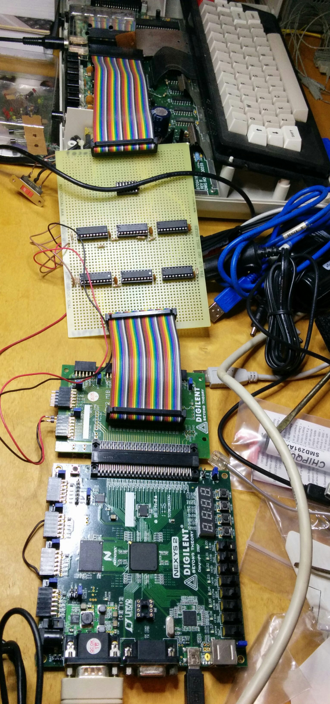
2011 – Early Prototype
Brendan Donahe & Steve Spiller
Initially planned to be a 6847 replacement
Migrated to “snooping” configuration due to signal timing difficulties – causing crashes
Xilinx Spartan 3E on Digilent board + perfboard with level shifters
Notes:
Other benefits to snooping include the ability for the 6847 to continue to drive analog video to TV (otherwise, this was going to be lost or I’d have to mimic it in the FPGA).
Design in Verilog
Fairly obvious why we had signal quality issues given segments of ribbon cable, large perfboard with level shifters, etc.

Slide 5
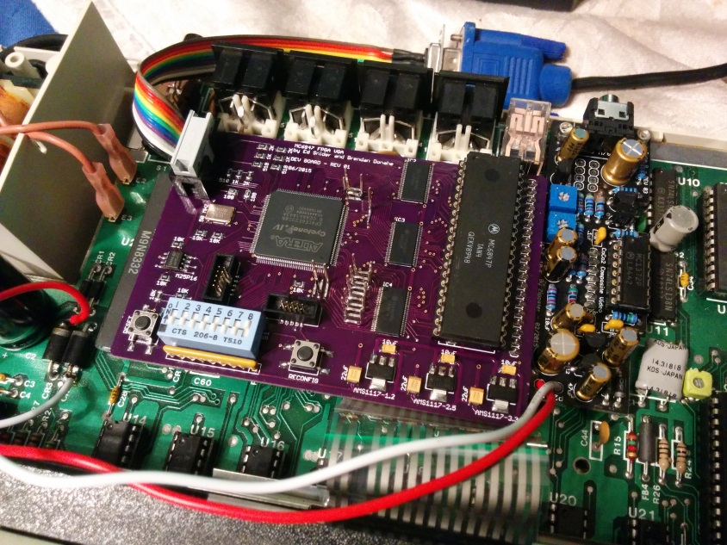
2015 – Mature Prototype
+ Ed Snider
Needed a board to improve signal quality
Moved to Altera Cyclone IV E and custom prototype

Slide 6
Current Status
Operational
Alphanumerics/SG4, 2 font sets
Most common graphics modes (including artifacting)
Enhancements:
Artifact color swap, double wide, or disable (monochrome)
Reverse video text
Border on/off
To do
Long-cycle modes not yet supported (PMODEs 0, 2 a.k.a. RG2, RG3)
Video quality issues on some VGA monitors
Test SG6, SG12, SG24
6847T1 (XC80652P) compatibility
Production boards
Notes:
Depending on which edge of the clock is used by 6847, artifacts will be red/blue or blue/red. CoCoVGA resolves this by letting the user pick the artifact color mode.
Another enhancement that I didn’t list here is scanline emulation (per Ed’s request)

Slide 7
Challenges
Variations in signal timing depending on clock edge used by 6847 (varies on power-up/reset)
Variations in signal timing depending on video mode (long cycle vs. short cycle)
Misunderstanding interactions with rest of system (SAM)
Notes:
Due to variations in which edge the 6847 uses, now sample this clock, synchronize it with the VGA pixel clock and produce a pulse on each rising and falling edge, for a double-speed clock.
Signal timing clock variation cause of artifact color red/blue vs. blue/red.

Slide 8
Interfacing with VGA and FPGA
 | CoCo | VGA
“Pixel” clock | 3.579545 MHz | 25 MHz
Frame rate | 30 Hz (60 fields/sec) | 60 Hz
Horizontal resolution | 256 | 640
Vertical resolution | 192 | 480
Colors | ~9 | 256 (really limited only by DAC)
`
CoCo resolution adapted to VGA: 512x384
256*2 = 512
192*2 = 384
CoCo +5V TTL, but FPGA +3.3V CMOS so level shifting necessary
Notes:
This is the start of the technical details section
The adapted CoCo resolution provides ~50 VGA pixels on each side of the usable video region for the 6847 border.

Slide 9
Reverse Engineering
Notes:
Connected to a 16k Color Basic CoCo 2

Slide 10
Text Mode Capture (Short Cycle)
Notes:
Set up logic analyzer to display 8-bit ASCII data from D[7:0]
In this situation:
short cycle timing, the same as our favorite PMODE 3 and 4 (a.k.a. CG6 and RG6 modes)
address in followed by 4 clocks and then data
character (and semigraphics) ROM is within 6847
same data will be read 12 times, once for each row of pixels within a text line
Graphics data is generally simpler, binary data representing color or set/unset info

Slide 11
“Overscan” Region
Notes:
SAM only pays attention to DA[0]. When DA[0] toggles enough times, then it increments its own upper bits of DA used for RAM access.
In other words, CoCoVGA cannot rely on all of the address signals output by the 6847 because the SAM ignores most of them.
Have to stop storage of data after rollover of DA[4:0], otherwise, 1 row of pixels is shifted down. Not too obvious in text mode, but very obvious in graphics modes.
If 6847 did not put up a border “mask” we might see these characters repeated in this “overscan” region.

Slide 12
CoCoVGA Snooping 6847
CSS, GM[2:0], A/G
VGA video
CoCoVGA
VGA monitor
DD[7:0]
DA[12:0]
6821
PIA
DRAM
DA[15:0]
6883
SAM
TV
DA[0]
NTSC video
6847
VDG
TV
Modulator
DD[7:0]
CSS, GM[2:0], A/G
analog video
Notes:
In CoCo, pins DD[6] also connected to INV and DD[7] also connected to A/S.

Slide 13
CoCoVGA Internal Architecture
FS
syncGen
VGA video sync
HS
VGA RGB
6847 video sync
D[12:0]
frameBuffer0
addrDataCapture
DD[7:0]
wrAddr
DA[12:0]
rdAddr
D[12:0]
PixelGen
A/G, A/S, CSS, INV
D[12:0]
D[12:0]
frameBuffer1
clockGen/
resetGen
wrAddr
rdAddr
Notes:
clockGen divides down 50MHz XTAL to 25MHz for pixel clock and samples/synchronizes the 6847 clock to pixelClk so that it pulses on both edges
syncGen samples FS (field sync) and HS (horizontal sync) to synchronize sampling in addrDataCapture as well as provide VGA VSYNC and HSYNC
addrDataCapture samples address and data on 6847 pins at the correct time, writes data and mode bits in frameBuffer as well as providing address to frameBuffer for reading
frameBuffers alternate reading/writing so that screen tearing doesn’t occur. This means that there are situations in which the displayed video may be 1/60th of a second behind a TV. Will have to see if gamers such as Neil or Stevie can notice it.

Slide 14
Any questions?
For a demo (or deep technical or philosophical discussions) please come by my table.
Notes:
Thanks for attending. This has been a only a shallow dive into this project. There is plenty more I could talk about, but I don’t care to take everyone’s time with tons of details. If there are some short/simple questions, then I’d be happy to answer them now, otherwise, we can talk 1:1 later – just stop by.

