Slide 2
Review
Status updates since CoCoFEST! 2016
Controlling CoCoVGA via
Software
Hardware
Notes:
We’ll start out with a summary of the project and its goals
Then move on to status updates since last year and
Then where we’ve been spending most of our time recently – user configuration of CoCoVGA

Slide 3
Review
Goal: Enable 6847-based systems (including Color Computers 1 and 2, MC-10, and Tano Dragon) to output VGA
Uses 6847 I/Os, snoops only digital signals to generate VGA
Started 2011 by Brendan Donahe & Steve Spiller with perfboard prototype
In 2015 asked Ed Snider to help – provided mature prototype and production boards

Slide 4
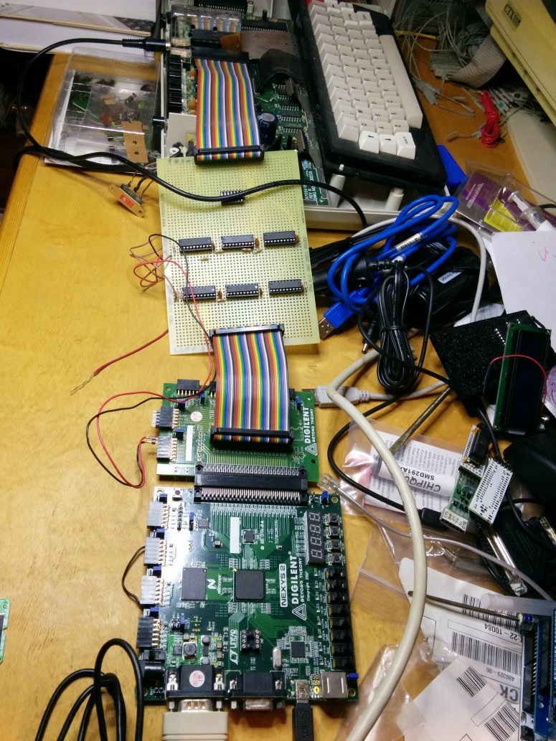
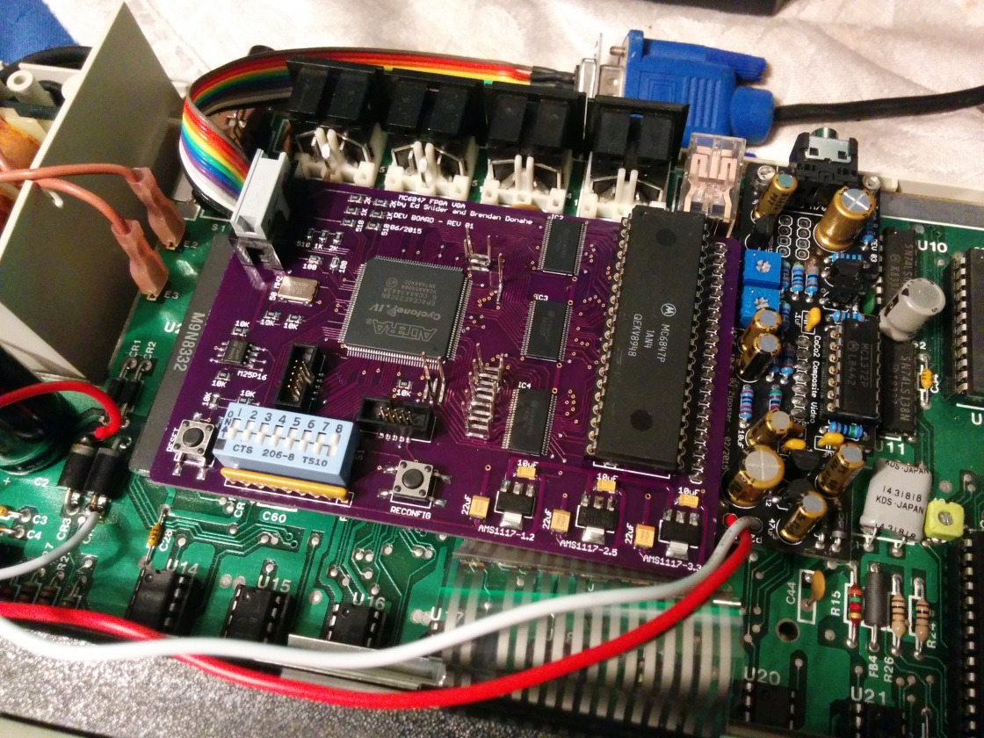
2011 - 2016
Notes:
Perfboard prototype from 2011
Ed’s board prototype from 2015 – note DIP switches. This was the one that was demo-ed last year.

Slide 5
Current Status
Since CoCoFEST! 2016
Fixed long-cycle modes (PMODEs 0, 2 a.k.a. RG2/3)
Fixed video quality issues
Added artifact modes, effects, color palette controls
Completed production board and hardware button board
Created DECB demo and configuration utility
Set up web site with downloads, documentation
To do
6847T1 (XC80652P) compatibility
Support systems other than rev B board CoCo 2
What about audio?

Slide 6
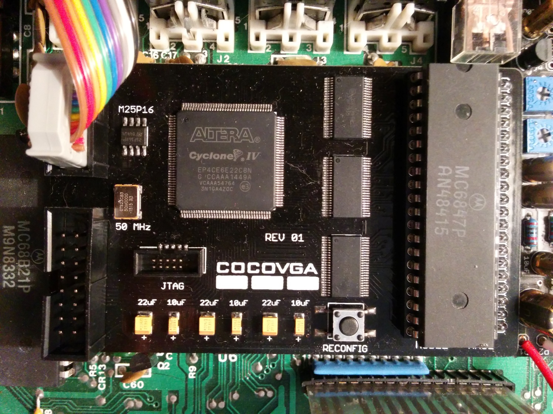
Production Board
Notes:
Summer 2016, started working with this board from Ed – drops the DIP switches
Plugged into CoCo 2 rev B board in the 6847 socket
Note 6847 in its socket, level shifters, FPGA, JTAG connector, XTAL, serial (SPI?) flash, VGA connector, debug header

Slide 7
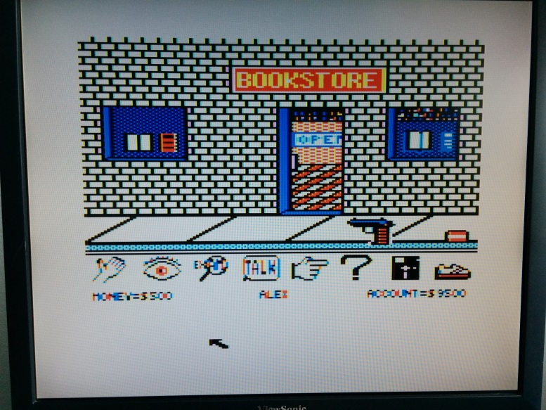
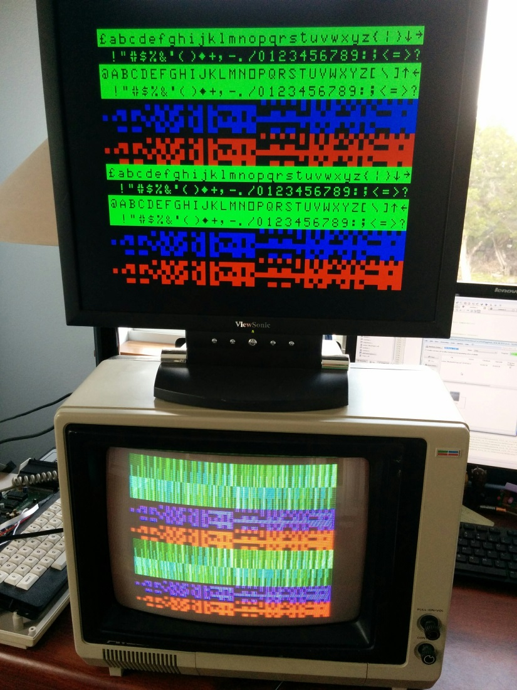
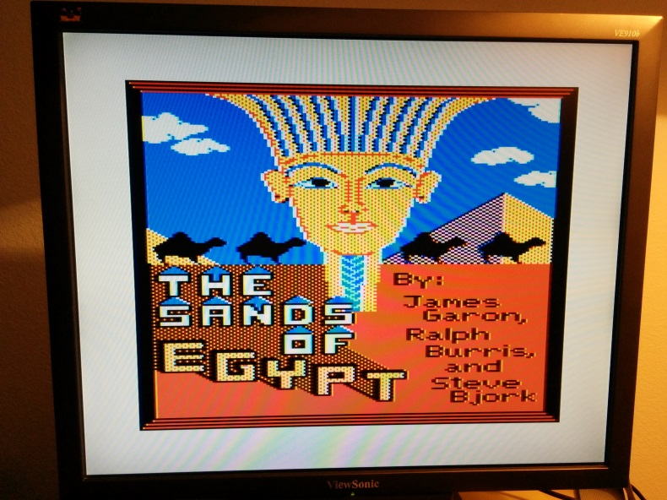
Screen Shots
Notes:
In the 2nd half of last year, I spent a lot of time with video modes and cleanup.
The left photo shows one CoCo driving both a VGA and composite monitor. SG6 and lower-case (which the non-T1 part cannot display) are visible on the VGA monitor. (The optional re-use of SG6 for lowercase, I believe, was a suggestion from Art Flexer.)
On the right are a couple of games that rely heavily on artifacting. These pictures show the MESS-style artifact mode.

Slide 8
Current Configurable Features
Character set (original vs. T1) and lowercase enable (SG6 or forced)
5 artifact color modes & color swap
Border color (standard, T1, off, custom)
Scanlines
Video mode change status
Inverse video
Palette
Omit dark reverse-video colors
Disconnect text palette from SG palette
Independently select each color out of 512 possible:
9 SG colors, 2 text colors, 2 dark reverse-video colors
Scanline color
Up to 16 “dithered” artifact colors (MESS mode)
VGA timing

Slide 9
So many features... ...but how do you configure them?
Notes:
I wanted all these features...
Not enough DIP switches for all of this even on the prototype board, and even if there were, they would be inside the case.
So a software solution would be preferred, especially for programming each 9 bit palette register...but there are really only 5 pins (CSS, A/G, GM) that can be directly addressed by the CoCo (via a PIA), and those affect what video output looks like.

Slide 10
Software Mode Control
blanking region n+0
video frame n+0 (CoCoVGA will display this)
program CoCoVGA combo lock
point SAM to alternate video frame which contains register settings
blanking region n+1
video frame n+1
(not actually video, but
register settings – CoCoVGA will not display this)
time
blanking region n+2
point SAM back to “displayable” video frame
video frame n+2 (CoCoVGA will display this)
blanking region n+3
Notes:
Want to program all of these settings, but need to do it in such a way that it doesn’t disturb video output.
Ideally we would program all registers during blanking region, but it could be tight.
1/60 second = 16.6s
Vsync for 32 scanlines our of 262 scanlines for the full display: 32/262 = 12.2% of image
12.2%*16.6s = 2.04ms
~1811 6809 clocks during FS
In other words, assuming average of 2.5 cycles/instruction, ~724 machine instructions during blanking period.
I would prefer to have a frame’s time to program it AND not have to bit-bang the PIA during the blanking period. So let’s let it read its own registers out of “video memory”.
Now review slide...
CSS, A/G, GM concatenated and used as 5-bit combination lock.

Slide 11
Software Mode Control Pros/Cons
Pros
Does not affect VGA video output
Pseudo-DMA of register settings if process interrupt-driven (offloads potential CPU bit-banging of PIA1)
Provides “high bandwidth” gateway to configure current and other potential future enhancements
Simple polling assembly-language routine working, callable from BASIC
Cons
Affects TV/composite video output (1 frame “flash”)
No control when running all legacy software (but stay tuned)
Register update rate dictated by refresh rate
Unable to read-modify-write; interface is write-only
Notes:
Bottom line: This approach is good for new software, or set-and-forget legacy applications where we can run a configuration application first.

Slide 12
Example CoCoVGA Registers
Reset and Edit Mask Registers
 |  | Bit Offset
Address Offset | Register Name | 7 | 6 | 5 | 4 | 3 | 2 | 1 | 0
0 | reset | reserved | VGA timing | extra palette | artifact palette | SG palette | extras | artifact | font
1 | edit mask | reserved | VGA timing | extra palette | artifact palette | SG palette | extras | artifact | font
SG Palette Register for Color 8 (Orange)
 |  | Bit Offset
Address Offset | Register Name | 7 | 6 | 5 | 4 | 3 | 2 | 1 | 0
48 | palette a | reserved |  |  |  | enable | red
49 | palette b | reserved |  | green |  |  | blue
Notes:
Here are some example registers in CoCoVGA
I’m highlighting these because they’re the ones we will be manipulating in our example program here in a moment.
The reset register lets us take all CoCoVGA registers back to factory defaults by setting 0x7F in offset 0
The edit mask register tells CoCoVGA which registers we want to update. For this example, we’ll be updating the SG palette, so look for bit 3 (value of 8) to be programmed into offset 1
I have chosen to replace the color orange with another color, so we’ll be manipulating offsets 48 and 49. In 48, we have to enable this palette register. Then we can set any of the remaining RGB values.
Look for full documentation on the web site.

Slide 13
Resources for SW Mode Control
Registers, in order of appearance...
PIA0A ($FF02) – write to clear pending VSYNC
PIA0B ($FF03) bit 7 – read VSYNC flag
SAM Page Select ($FFC6-$FFD3)
Write to set which 512-byte page to provide to 6847
7 bits spread across 14 addresses (odd set, even clear)
PIA1B ($FF22) bits [7:3]
Read/write 6847 control pins A/G, GM[2:0], CSS, respectively
Example memory map
$400 – alpha/SG4 video page used by BASIC (SAM page 2)
$6C00 – assembly language routine
$7000 – 512-byte CoCoVGA register page (SAM page 56)
Notes:
Who’s who of the registers and an example memory map needed to accomplish the task at hand
In order of appearance...
VSYNC flag falls (asserted low) during the blanking period
SAM Page Select: Note 512 bytes * 2^7 = 64k bytes, the full address range of the CoCo 2. Fun to play with – you can easily, in BASIC, set up PMODE 3 or 4 graphics modes, and then point this to various segments of memory to get a “visual” of code/data residing in those locations. There are some segments in low memory that are active with BASIC updates.
PIA1B is what is used to program the combo lock and then later restore the mode that we came from

Slide 14
Calling from ECB
10 CLEAR 200,&H6BFF
20 LOADM”SG4PG2.BIN”
30 DEFUSR0=&H6C00 ‘ML ROUTINE START
40 R=&H7000
50 RI=INT(R/512) ‘R/512 IS FLOAT BY DEFAULT
60 FOR I=R TO R+511:POKE I,0:NEXT
70 POKE R,&HFF ‘RESET ALL REGS
80 POKE R+1,&H08 ‘EDIT SG PALETTE REGS
90 POKE R+48,8:POKE R+49,7 ‘ORANGE -> BLUE
100 A=USR0(RI) ‘PROGRAM COCOVGA REGISTERS
Notes:
Before we delve into the assembly language routines, let’s look at this from a standpoint of how we want to use it from BASIC. (Credit goes to Steve Spiller for putting together an initial working example of this software – both the BASIC and assembly portions.)
10 Clear out some string space (unnecessary) and start address of reserved region of memory for our machine language routine
20 Load ML routine from disk, will drop in at $6C00. This particular routine assumes that we want to return to text mode on page 2. This routine is what we’ll talk about on the next few slides.
30 Set up user-defined machine language call
40 Pointer to page of RAM that we want to use for registers
50 Compute 16-bit integer to be passed to ML routine
60 Clear out RAM to be used for register space – don’t really need to clear all 512 bytes, only the registers we need per our edit mask.
70 Start setting up registers – reset all CoCoVGA registers to factory defaults (note that this is not really applied to the FPGA yet)
80 Tell CoCoVGA to pick up SG palette register settings (also not really applied to CoCoVGA yet)
90 Tell CoCoVGA that semigraphics color number 8 (in register offsets 48 and 49) should instead be blue (still not applied to CoCoVGA)
100 Actually get CoCoVGA to perform the register update – we could have used a hardcoded value here, but passing a parameter through USR0 lets us have multiple pages of register settings available. This example just has one.
Can also edit many other registers at the same time; this example just shows updating 1 aspect – that of a single color.

Slide 15
Assembly Polling Routine – Part 1
00130 LDA $FF02 CLEAR ANY PENDING VSYNC FLAG
00140 TLP LDA $FF03 WAIT FOR FLAG TO INDICATE...
00150 BPL TLP ...FALLING EDGE OF FS
00152 LDA $FF02 CLEAR VSYNC INTERRUPT FLAG
00155 * SET THE SAM GRAPHICS PAGE OFFSET FROM USR PARAM
00160 JSR $B3ED PLACE THE USR0 PARAM IN D REG
00170 TFR B,A WE ONLY WANT THE LOWER 8 BITS
00180 BITA #$01 CHECK ARG BIT 1 SET
00190 BEQ BT0 IF SET
00200 STA $FFC7 SET SAM GRPHOFF BIT 1 TO 1
00210 BRA BT1 ELSE
00220 BT0 STA $FFC6 SET SAM GRPHOFF BIT 1 TO 0
00230 BT1 BITA #$02 REPEAT....
Notes:
This routine is generic, other than returning us to a particular mode and return SAM page setting, and it could be made more generic if it checked mode and saved the SAM page from BASIC.
I’ll be showing just excerpts, to avoid the minor, less interesting parts. Prior to this, we might save the CC register (where interrupts are masked) and mask interrupts
First code snippet - clear any current VSYNC, poll for the falling edge
Repeat lines 180 through the label at 230 for each bit of the SAM offset register (which picks off 512-byte pages to point to for video RAM).

Slide 16
Assembly Polling Routine – Part 2
00525 * PROGRAM THE COCOVGA COMBO LOCK
00530 BT13 LDA $FF22 GET CURRENT PIA VALUE
00540 TFR A,B COPY TO B REG TOO
00550 ANDA #$07 MASK OFF BITS WE'LL CHANGE
00560 ORA #$90 SET COMBO LOCK 1 BITS
00570 STA $FF22 WRITE TO PIA FOR COCOVGA
00590 ANDA #$07 CLEAR UPPER BITS
00600 ORA #$48 SET COMBO LOCK 2 BITS
00610 STA $FF22 WRITE TO PIA
00630 ANDA #$07 CLEAR UPPER BITS
00640 ORA #$A0 SET COMBO LOCK 3 BITS
00650 STA $FF22 WRITE TO PIA
00670 ANDA #$07 CLEAR UPPER BITS
00680 ORA #$F8 SET COMBO LOCK 4 BITS
00690 STA $FF22 WRITE TO PIA
00710 ANDA #$07 CLEAR UPPER BITS
00720 ORA #$00 SET REGISTER BANK 0 FOR COCOVGA
00730 STA $FF22 WRITE TO PIA
00785 * WAIT FOR NEXT VSYNC SO COCOVGA CAN PROCESS DATA FROM THE
00787 * CURRENT VIDEO PAGE
00820 TLP2 LDA $FF03
00830 BPL TLP2
00832 LDA $FF02 CLEAR VSYNC INTERRUPT FLAG
00835 * RESTORE PIA STATE AND RETURN TO TEXT MODE – RESTORE ORIGINAL VIDEO MODE, SAM PAGE
Notes:
Program combo lock by way of read/modify/write then mask/or/write, mask/or/write, etc.
Now CoCoVGA is unlocked and ready to consume the register settings from the “video page” BASIC set up.
We poll again until the next blanking period to make sure CoCoVGA consumes the data. Naturally, following this, we must restore original video mode via PIA, the SAM page pointer, and unmask interrupts.

Slide 17
Compatible Software
Mode Demo
Demonstration of on-the-fly software configuration
CoCoVGA Configuration Utility
Menu driven
Configure all features
Save/load configuration
Run saved configurations as standalone BASIC programs
Notes:
Software which currently uses CoCoVGA Software Mode Control include...
These are all Disk Extended Color BASIC – 64k for now, might be able to trim it down...

Slide 18
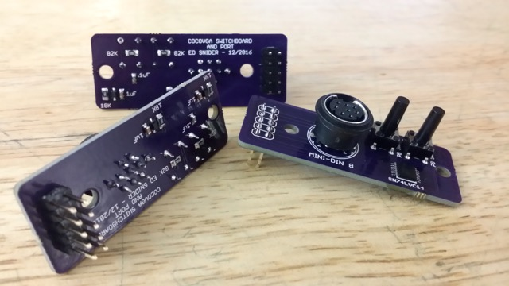
Hardware Mode Control
Secondary board from Ed - connects to VGA header on CoCoVGA, providing:
2 debounced pushbuttons
mini DIN connector for VGA output to monitor
Notes:
What about legacy software where you want to change modes on-the-fly or cartridges where you can’t run a software configuration utility? Or you simply don’t care to run one?
Ed created this small board for the purposes of providing a round mini-DIN plug, 2 round momentary debounced pushbuttons, and 2 screw holes (for ease of installation via drill/round file).
Arrived under 2 weeks ago, so getting this hooked up and getting the Verilog updated with some state machines for this is recent news.

Slide 19
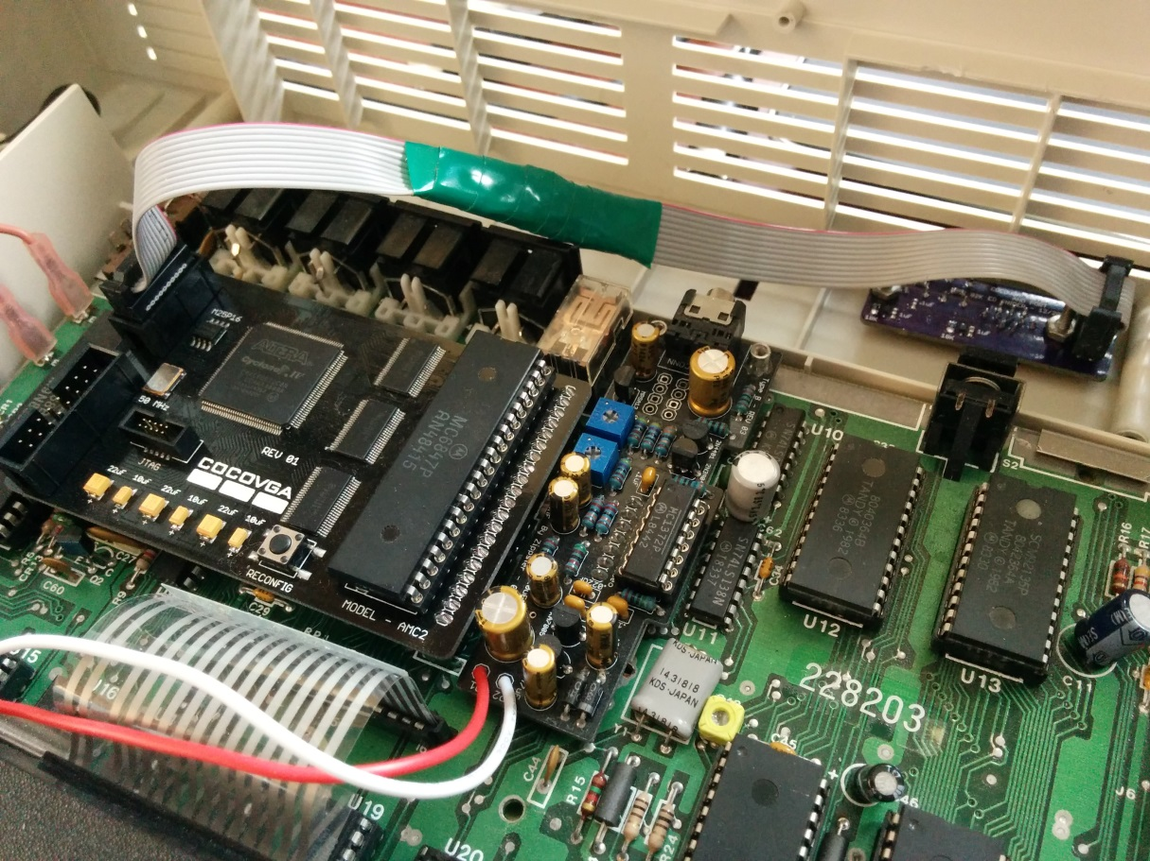
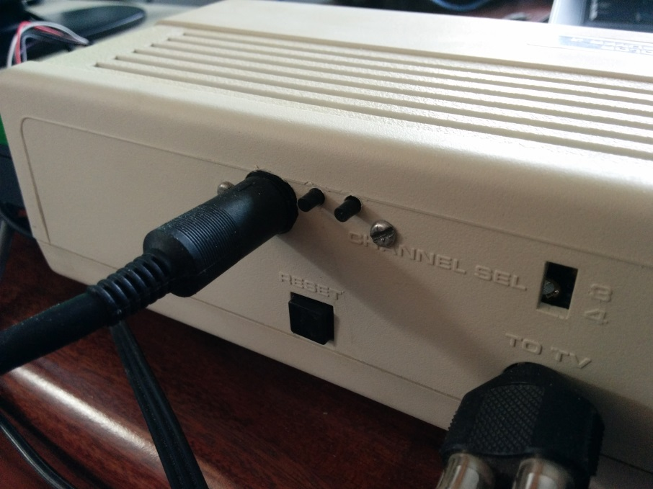
Hardware Mode Control Cont’d
Notes:
Here it is installed in one of my CoCo 2s (as of last weekend).

Slide 20
Hardware Mode Control
Context-sensitive: buttons change meaning depending on video mode
Text & SG
RG1/2/3 & CG
RG6
Enables selection of
Basic text colors and features (inverse, lowercase)
Artifact color swap and mode
Border on/off and status
Scanlines
Notes:
Although the buttons change meaning depending on video mode, I tried to keep similar functions in the same place across contexts.
FPGA recognizes press vs. hold
How the buttons cycle through modes is documented on the web site

Slide 21
Any questions?
For a demo please come by my table.
Please also visit:
www.cocovga.com
Notes:
Thanks for attending. There is plenty more I could talk about, but I don’t care to take everyone’s time with tons of details. If there are some short/simple questions, then I’d be happy to answer them now, otherwise, we can talk 1:1 later – just stop by.

Slide 22
CoCoVGA Snooping 6847
CSS, GM[2:0], A/G
VGA video
CoCoVGA
VGA monitor
DD[7:0]
DA[12:0]
6821
PIA
DRAM
DA[15:0]
6883
SAM
TV
DA[0]
NTSC video
6847
VDG
TV
Modulator
DD[7:0]
CSS, GM[2:0], A/G
analog video
Notes:
In CoCo, pins DD[6] also connected to INV and DD[7] also connected to A/S.

Slide 23
CoCoVGA Internal Architecture
FS
syncGen
VGA video sync
HS
VGA RGB
6847 video sync
D[12:0]
frameBuffer0
addrDataCapture
DD[7:0]
wrAddr
DA[12:0]
rdAddr
D[12:0]
PixelGen
A/G, A/S, CSS, INV
D[12:0]
D[12:0]
frameBuffer1
clockGen/
resetGen
wrAddr
rdAddr
Notes:
clockGen divides down 50MHz XTAL to 25MHz for pixel clock and samples/synchronizes the 6847 clock to pixelClk so that it pulses on both edges
syncGen samples FS (field sync) and HS (horizontal sync) to synchronize sampling in addrDataCapture as well as provide VGA VSYNC and HSYNC
addrDataCapture samples address and data on 6847 pins at the correct time, writes data and mode bits in frameBuffer as well as providing address to frameBuffer for reading
frameBuffers alternate reading/writing so that screen tearing doesn’t occur. This means that there are situations in which the displayed video may be 1/60th of a second behind a TV. Will have to see if gamers such as Neil or Stevie can notice it.

