Slide 1
Everything in the MC-10 but the (Kitchen) SYNC
Brendan Donahe

Slide 2
Acknowledgements
Standing on the shoulders of MC-10 giants:
Darren Atkinson
Simon Jonassen (who also contributed to the paper “The 6803 Timer as VSYNC Surrogate)
John Linville
Thanks to Jim Brain for this presentation’s title; I accept blame for the remainder of the puns and idioms in this presentation

Slide 3
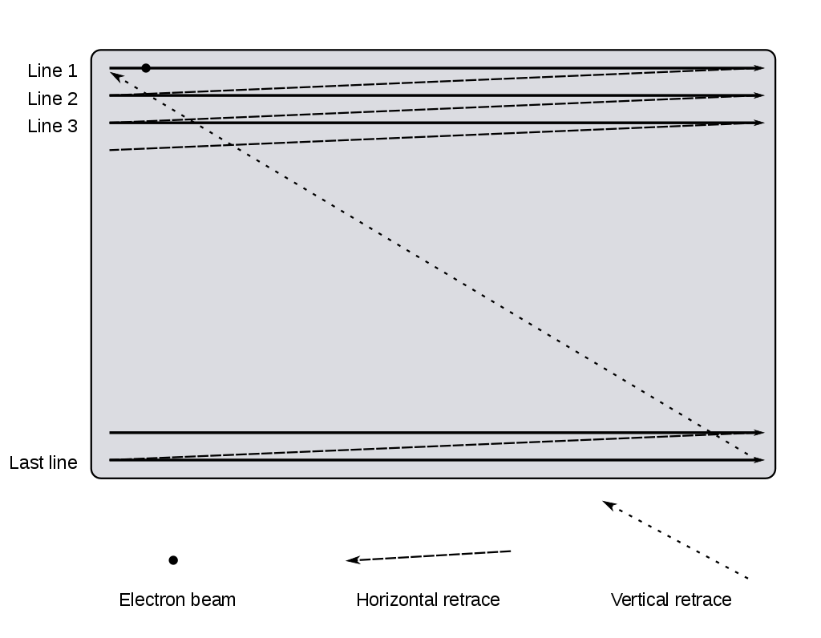
Raster Scan and Vertical Retrace
Notes:
Quickly “refresh” ourselves with respect to video synchronization…
CRT raster scan diagram, showing how all old TVs “painted a picture” and still today how we stream pixels out of a computer or video game system.
Note the “vertical retrace”. That takes some time and during that time, video is invisible. This is the vertical blanking region.
Horizontal sync is happening at the right edge of the screen at the end of each line of pixels. Vertical sync occurs in the bottom right corner when done drawing the entire screen.

Slide 4
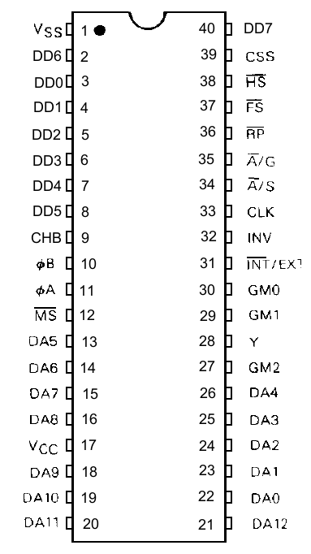
That SYNCing Feeling
HSYNC
Triggered in horizontal retrace
HS in 6847 pinout
Happens at frequency of 15.734kHz or every ~63.6us
VSYNC
Triggered in vertical retrace
FS (Field Sync) in 6847 pinout
Happens 60 times/second or every ~16.67ms
Notes:
This is the pinout for the Motorola 6847 chip, also known as the VDG (Video Display Generator). It’s used in CoCo 1s and 2s, MC-10s, and Dragons, as well as some other systems that didn’t make their way to the US.
HS and FS have “bars” over the tops of them because they are asserted low (0V during retrace/blanking region) and high (~5V) otherwise.

Slide 5
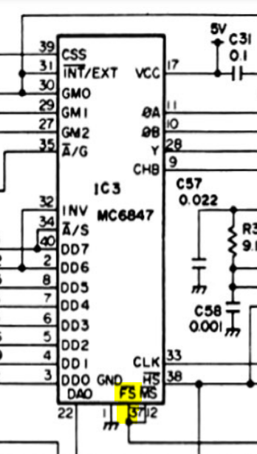
CoCo has what MC-10 doesn’t?
Notes:
On left – early American made CoCo 2 schematic
On right – MC-10 schematic

Slide 6
Why Does VSYNC Matter?
Enables software to avoid “tearing” by performing video memory remapping or updates during the blanking region
Provides 60Hz periodic interrupt for triggering regularly recurring events in software
Allows software to communicate with CoCoVGA to access enhanced features such as:
setting palette colors
64-column text mode
16-color 128x96 (VG6) video mode
Notes:
Why do we care?

Slide 7
Don’t Abandon the SYNCing Ship!
MC-10 has a MC6803 CPU with built-in timer…
Can this timer be tuned to the same frequency as VSYNC and trained to align with the blanking region?
Notes:
Don’t give up hope on getting these features into the MC-10!
Motorola 6803 has something the CoCo’s 6809 doesn’t – a built-in timer!
Can we tune this timer and use it in place of VSYNC?

Slide 8
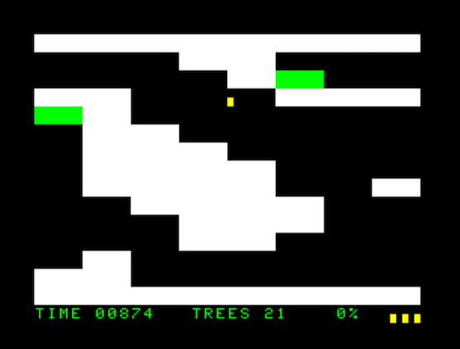
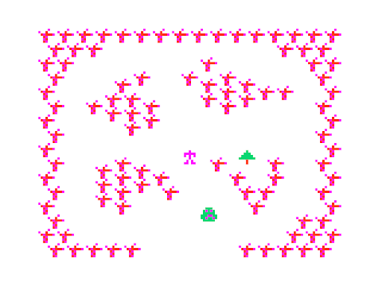
Spoiler! It Can!
John Linville’s Xmas Rush for the MC-10
Darren Atkinson’s port of Lee Patterson’s Bouncy Ball for the MC-10
Notes:
Two examples of software which have the ability to train the MC-10’s 6803 timer in this way include…

Slide 9
Something to SYNC Your Teeth Into
Step 1: Train 6803 timer with help from user
Step 2: Use trained timer to enable
Synchronized sequencing of the CoCoVGA combo lock and providing register settings on next video frame
Synchronized switching back to visible video
General ability to avoid tearing during video memory updates
Notes:
Overall procedure…

Slide 10
Tick Tock
Timer uses CPU clock (at 0.895MHz, like the CoCo)
57 CPU clock cycles per video scanline
262 scanlines per frame (not all of them visible)
Total of 14934 timer ticks per frame
Notes:
Explanation of math here courtesy of Simon Jonassen – 6847 and 6803 specs made it look like the answer was much more complicated than this.

Slide 11
Time’s a-waistin’!
6803 timer is 16-bit free running (mostly read-only) and visible at addresses $09:$0A
Output Comparison value is therefore also 16-bit and can be written at addresses $0B:$0C
Configure timer to trigger CPU interrupt on Output Compare match
Interrupt Service Routine (ISR) adds 14934 to Output Comparison value each time, keeping frequency of interrupt fixed at VSYNC rate

Slide 12
Time Marches On…
16.67ms
16.67ms
16.67ms
Timer $09:$0A
…0…
…14934…
…29868…
…44802…
Timer Output Compare Interrupt! +14934
Timer Output Compare Interrupt! +14934
Timer Output Compare Interrupt! +14934
Timer Output Compare Interrupt! +14934
Output Compare
$0B:$0C
0
14934
29868
44802
59736
Notes:
Here’s a graphical representation of the information in the previous slide.
ISRs in orange boxes.
Free running timer starts at 0 just to make slide a bit easier to follow… In actuality, it’s very likely it would NOT be 0 at any given time.

Slide 13
Changing Times
Frequency is matching, now need to align with 6847’s FS (VSYNC)
ISR manipulates CSS (Color Set Select) control of 6847 VDG to make the display orange in a small segment of the display
This region can be moved by the user until it disappears off screen into the vertical blanking region
User pressing arrow keys temporarily adjusts Output Comparison value by + or – 96 (arbitrary value)
User presses <ENTER> once orange region is not visible

Slide 14
Spring Forward or Fall Back?
16.67ms
16.56ms
16.56ms
Timer $09:$0A
…0…
…14934…
…29772…
…44610…
TOC Interrupt! Up arrow pressed! +14934 -96
TOC Interrupt! Up arrow pressed! +14934 -96
TOC Interrupt! +14934
TOC Interrupt! +14934
Output Compare
$0B:$0C
0
14934
29772
44610
59544
Notes:
ISRs depicted as orange boxes.
If up arrow is pressed, we want the orange CSS region earlier in time so subtract from the next TOC offset. (Depicted here.) Note that the period of the timer is temporarily shortened in this example.
If down arrow is pressed, we want the orange CSS region later in time so add to the next TOC offset. (Not depicted here.)
User presses <ENTER> when they have the orange CSS region off-screen.

Slide 15
Programming CoCoVGA
Now that 6803 timer (with help from its friendly maintenance ISR) is providing VSYNC-timed periodic interrupts…
Can program CoCoVGA combo lock
Provide CoCoVGA register settings or upload a character set during next video frame
Revert video to something more interesting for the user

Slide 16
Third Time’s A Charm
16.67ms
16.67ms
16.67ms
TOC Interrupt!
TOC Interrupt! Program CoCoVGA combo lock via CSS, A/G, GM[2:0]
TOC Interrupt! Quickly clean up screen and show user something else
Provide CoCoVGA register settings via next hidden video frame
Notes:
ISRs shown by orange boxes.
Every TOC interrupt updates the Output Compare so that the interrupts continue at the same periodic rate.
If the programmer wishes to update CoCoVGA registers, the ISR (which is running in the blanking region) must enter the combination lock’s code.
Then the register settings (or character set) must be allowed to stream in during the next video frame while CoCoVGA displays the old video frame (since it’s double-buffered).
On the final interrupt, it’s time to quickly clean up the video screen so that the user doesn’t have to see the CoCoVGA register setting or character set “garbage”. (On the CoCo this is not an issue because the SAM can be used to switch to another region of memory very quickly – see next side.)

Slide 17
SYNCing Down to the MC-10’s Level
Caveats:
MC-10 still doesn’t have a SAM (MC6883) like the CoCo that allows pointing to any 512-byte-aligned region as the start of video memory
This means CoCoVGA register settings or character sets to upload may be in a region visible to the user unless they can be erased and replaced quickly during the blanking region

Slide 18
DEMO

Slide 19
Further Reading
The 6803 Timer as VSYNC Surrogate
6847 VDG Spec
CoCo 2 Service Manual
6801 (and 6803) Programmer’s Reference
MC-10 Service Manual

