Slide 1
64-Column Text Mode
…because your 6809 has better things to do than render text.
Notes:
Hi, my name is Brendan Donahe. I’m what you might call the logic designer of the CoCoVGA project. That means that the majority of my contributions there have been on the FPGA part of the design.
Today I’ll be talking about how I got the CoCoVGA 64-column text mode working with BASIC. Hopefully this will be interesting even for folks who have no interest in CoCoVGA but might be curious about customizing BASIC for their own purposes.

Slide 2
Quick CoCoVGA project review
CoCoVGA status updates since CoCoFEST! 2017
Patching BASIC for 64-column text
Enabling 64x32 text/SG mode on CoCoVGA
Entering all-RAM mode
SCREEN and “unsupported” CG2 PMODE
Tabs, scrolling, SET/RESET, PRINT @, CLS, etc.
Notes:
We’ll start out with a summary of the CoCoVGA project and its goal
Then we’ll move on to status updates since 6 months ago and
Finally spend most of our time talking about hacking BASIC

Slide 3
Project Review
Goal: Enable 6847-based systems (including Color Computers 1 and 2, MC-10, and Tano Dragon) to output VGA
Uses 6847 I/Os, snoops only digital signals to generate VGA
Started 2011 by Brendan Donahe & Steve Spiller with perfboard prototype
In 2015 asked Ed Snider to help
Notes:
So to review – see slide…
Ed has been providing multiple revs of high quality boards.
He has also been writing some software for the enhanced CoCoVGA modes, such as the VG6 16-color mode.

Slide 4
Project Status
Since CoCoFEST! 2017
Completed 6kB 128x96 16-color mode
Added 2kB 64 column x 32 row text-and-SG mode
Updated color palette controls for future palette backward-compatibility
To do
6847T1 (XC80652P) compatibility
Support systems other than rev B board CoCo 2
Audio
Other enhancements to FPGA design
Notes:
Had an early demo of the 128x16 16-color mode working at CoCoFEST, but was not fully complete.

Slide 5
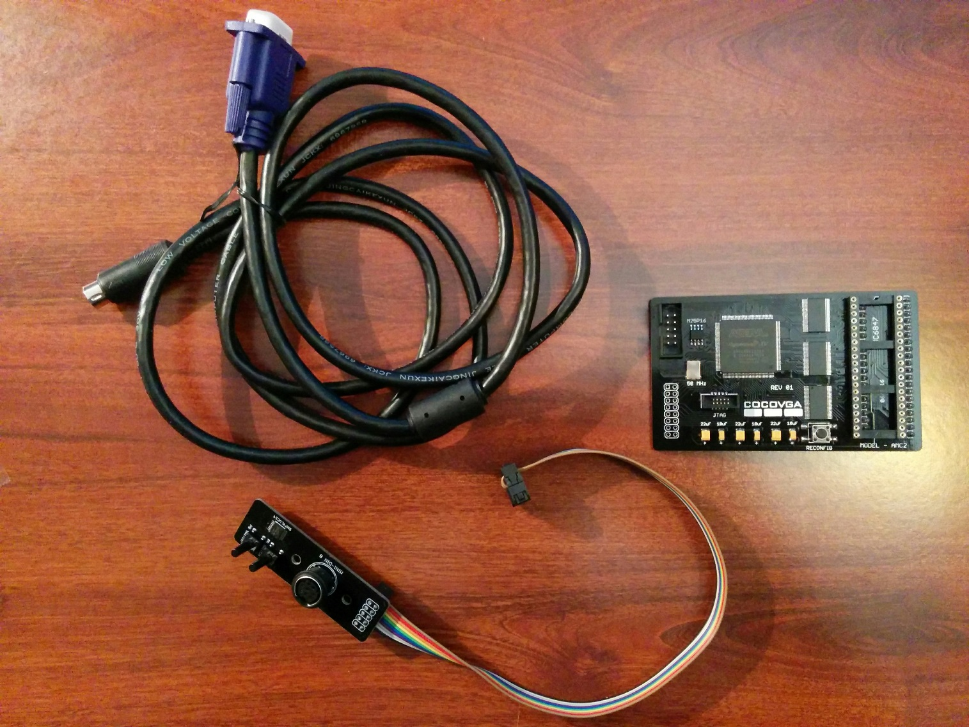
Production Kit - Now Available!
Notes:
I’m happy to announce that thanks to Ed putting together a batch of boards and cables, CoCoVGA is now available! I have these with me this time, so let me know if you want one.
This kit is for the CoCo 2 rev B board with 6847 (not the T1), although I have also fit one into a US Tano Dragon without difficulty (other than non-destructively desoldering the 6847 and replacing it with a socket). If you have a system other than these 2, we can still take a look and see if there’s any way to make one fit.
This should be electrically compatible with any 6847-based system. The issue would most likely be in the physical layout of the board.
With respect to the audio concern, Ed has also provided some composite and audio mods for use with rev B CoCo 2 boards. I have some of those with me, as well.

Slide 6
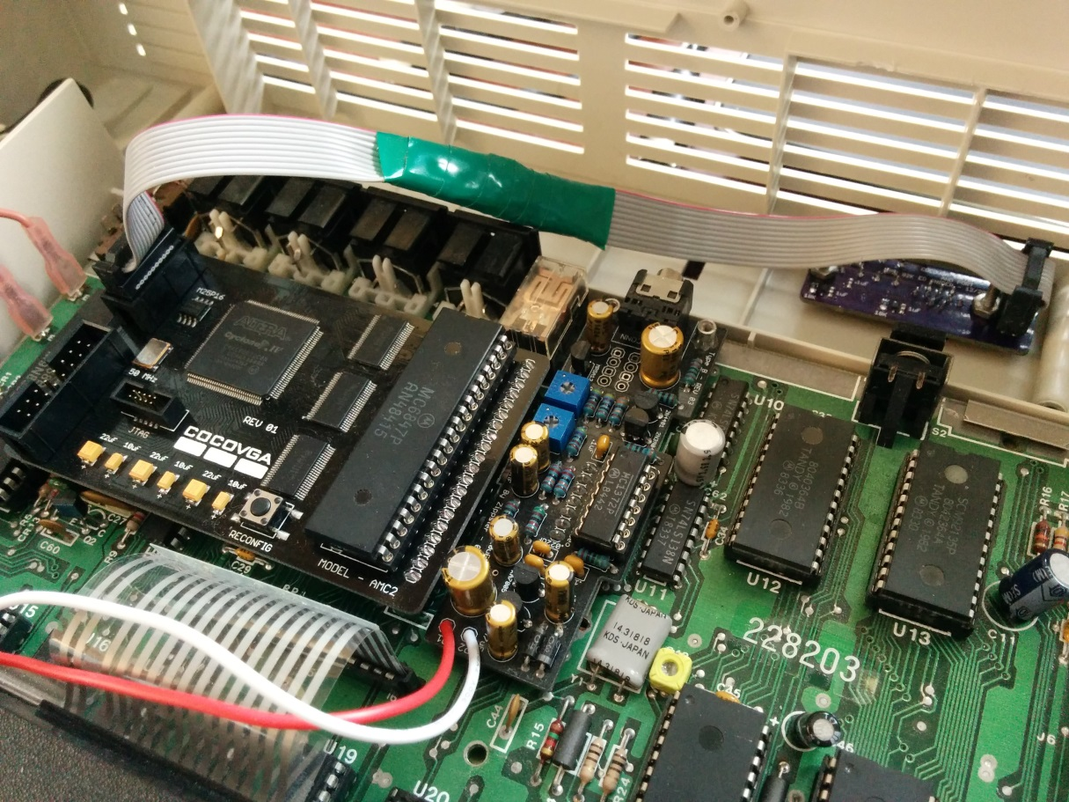
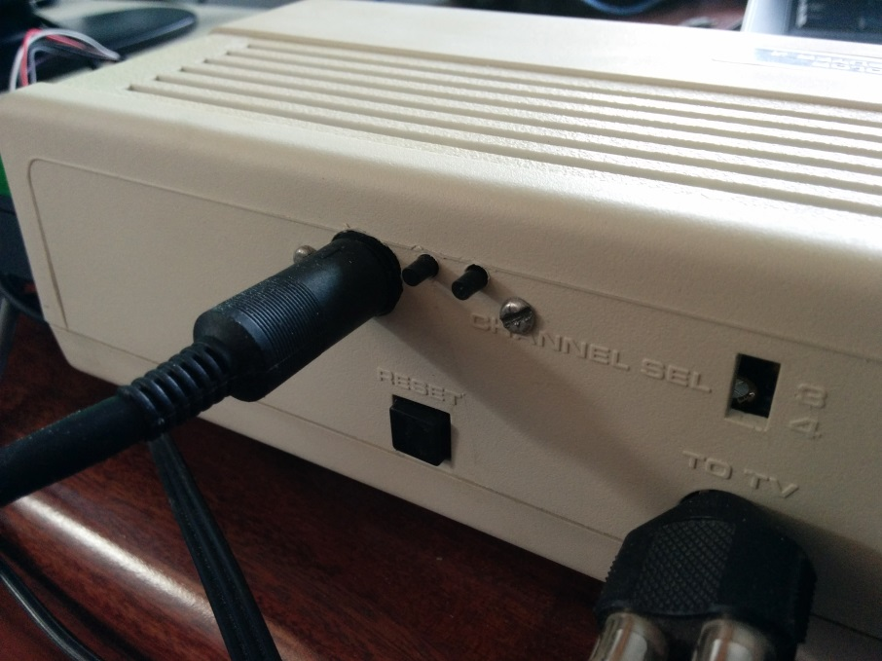
Production Kit – Example Installation
Notes:
Here’s one of the early production boards installed in my daily-driver CoCo 2. I have modified the case to install the button board on the back panel to avoid running the ribbon cable out between the case halves and to provide a solid connection point for the VGA cable.

Slide 7
Why 64-Column Text in HW?
Offloads 6809 from having to draw text in PMODE 4/RG6 to achieve similar functionality
64 columns by 32 rows
straightforward to implement in FPGA
maps cleanly to 6847 addressing and character set
Feature I have always wanted for:
Text adventures
OS-9
Programming
Notes:
I always felt that it could be better if we could offload the 6809 to do more useful work than rendering text in the situations where we want more than 32 columns. Scrolling and redraw takes much more effort on the part of the 6809 when operating in graphics modes than manipulating just a single byte-per-character.
Given addressing and page size, 64 columns is much easier to implement in the FPGA than 80 columns. Also, doubling pixel density in both X and Y is ideal over 2.5x for 80 columns or by adding another character set.
A feature I have always wanted in the CoCo 2 was the ability to have hardware-supported text of more than 32-columns, for text-based games, heavy-duty operating systems, and programming.

Slide 8
BASIC 64-Column Mode Requirements
64kB RAM
DECB (or compatible)
CoCoVGA
Notes:
To do this in its current form requires a 64kB CoCo – we wouldn’t be able to copy ROM-to-RAM, enter all-RAM mode and patch BASIC without enough memory…
Disk Extended Color BASIC (or one of the many other RS-DOS-alikes) is needed for this example because we’re making assumptions about where the graphics mode RAM pages will be placed.
And of course, you need CoCoVGA to interpret the graphics data as ASCII with semigraphics.

Slide 9
6847 vs. BASIC Modes
Spec Mode | Resolution | Colors | RAM Size | 6847 mode | BASIC SCREEN | BASIC PMODE
RG6 | 256x192 | 2 | 6kB | 7 | 1 | 4
CG6 | 128x192 | 4 | 6kB | 6 | 1 | 3
RG3 | 128x192 | 2 | 3kB | 5 | 1 | 2
CG3 | 128x96 | 4 | 3kB | 4 | 1 | 1
RG2 | 128x96 | 2 | 1.5kB | 3 | 1 | 0
CG2 | 128x64 | 4 | 2kB | 2 |  | “-1”?
RG1 | 128x64 | 2 | 1kB | 1
CG1 | 64x64 | 4 | 1kB | 0
Text/SG | 32x16/64x32 | 2/8+ | 0.5kB | N/A | 0
Notes:
Initially, I posted a video on YouTube with all of this working in the RG6 mode, which by far has the most convenient addressing, with no repeated rows of data. Unfortunately, it required that the end user use one of the CoCoVGA configuration buttons on the back of the machine should they want to toggle between PMODE 4 for graphics AND for 64-column text mode.
Also, the new 64-column text mode is 64x32 for a total of 2kB, so we really don’t need all 6kB.
Later, I changed this to CG2 which is the only mode with an exact fit from a memory footprint standpoint. This was a bit more challenging to get set up in the FPGA due to the way the 6847 reads rows of data and I uncompress and store in the internal ping-pong frame buffers within the FPGA to support color set changes on a per-pixel-row basis.
Our most significant software challenge here is to get BASIC to think that the text/semigraphics mode is CG2…or you might even say PMODE “-1”. Of course, you can’t issue a PMODE -1 command to the CoCo; you get an FC error because that’s out-of-range.
Also, a bit of a foreshadowing: notice the delta between the 6847 mode and the BASIC PMODE. One is offset from the other by 3.

Slide 10
DECB 64-Column Memory Map
Region | Size | Contents
$0000-$03FF | 1024 | BASIC System RAM
$0400-$05FF | 512 | 32-column text and semigraphics (unused)
$0600-$0DFF | 512 | Disk System RAM
$0E00-$13FF | 1536 | PCLEAR page 1 – start 64-column video memory here
$1400-$19FF | 1536 | PCLEAR page 2 – 64-column video uses first 512 bytes
$1A00-$6BFF | 20991 | Free for BASIC program
$6C00-$6FFF | 512 | CoCoVGA ML routine (reclaimable after use)
$7000-$71FF | 512 | CoCoVGA “register” page (reclaimable after use)
$7200-$7235 | 53 | ROM-to-RAM ML copy routine (reclaimable after use)
$7236-$7FFF | 3529 | Free
$8000-$DFFF | 24575 | DECB ROMs
http://www.cocopedia.com/wiki/index.php/Color_Computer_2_Memory_Map
Notes:
We are about to slice up memory like this.
We will no longer be using the 512-byte region between hex 400 and hex 5FF that is normally used for standard 32-column text and semigraphics because it’s just not big enough for a 2kB region – it’s hemmed in by memory reserved for BASIC and disk - but we can PCLEAR 2 1.5kB pages to get us the 2kB we need for our 64x32 text screen, and then use the region from hex E00 to hex 15FF.
We’ll place all of our machine language routines up in higher memory – I haven’t done a very careful job of pushing these as high as they can go, but that could be remedied. Note that these regions could potentially be reclaimed after they are used because they aren’t really needed after they get CoCoVGA and all-RAM mode set up the first time.
Last, but not least, we have the hex 8000 to hex DFFF regions that are currently in ROM and we need to get them into RAM so that we can hack them, hence the ROM-to-RAM copy routine.
(Source for non-project-specific info in this table: http://www.cocopedia.com/wiki/index.php/Color_Computer_2_Memory_Map)

Slide 11
Configure CoCoVGA
10 CLEAR 500,&H6BFF ‘RESERVE SPACE FOR REGS AND ML ROUTINE
20 PCLEAR 2 ‘RESERVE SPACE FOR 64-COLUMN TEXT MODE
30 GOSUB 1000
…
1000 LOADM"SG4PG2.BIN"
1010 DEFUSR=&H6C00
1020 R=&H7000
1030 RI=INT(R/512)
1040 FOR I=R TO R+511:POKE I,0:NEXT ‘CLEAR ALL MEMORY TO BE USED FOR REGS
1050 POKE R,&HFF ‘RESET ALL SETTINGS IN COCOVGA
1060 POKE R+1,&H80 ‘ENABLE ENHANCED MODE REG
1070 POKE R+8,2 ‘ENABLE 64-COLUMN MODE
1080 A=USR0(RI)
1090 RETURN
Notes:
At the last CoCoFEST, I described ad naseum how we get CoCoVGA to comprehend mode and palette change requests – to briefly review, we are basically using the A/G, CSS, and A/S pins as a combination lock during the vertical blanking region to tell it the next frame of video is actually data.
I have a small assembly language routine that watches for this blanking region and programs this combo lock, and we’re going to place it at $6C00. (The other value is string space allocation.)
We’re placing a 512-byte region at $7000 which will be read by the SAM as though it is a standard text video frame, but CoCoVGA is going to use it to stream data into its internal registers to configure it for 64-column mode.

Slide 12
Allocate Video RAM
10 CLEAR 500,&H6BFF ‘RESERVE SPACE FOR REGS AND ML ROUTINE
20 PCLEAR 2 ‘RESERVE SPACE FOR 64-COLUMN TEXT MODE
30 GOSUB 1000
…
1000 LOADM"SG4PG2.BIN"
1010 DEFUSR=&H6C00
1020 R=&H7000
1030 RI=INT(R/512)
1040 FOR I=R TO R+511:POKE I,0:NEXT ‘CLEAR ALL MEMORY TO BE USED FOR REGS
1050 POKE R,&HFF ‘RESET ALL SETTINGS IN COCOVGA
1060 POKE R+1,&H80 ‘ENABLE ENHANCED MODE REG
1070 POKE R+8,2 ‘ENABLE 64-COLUMN MODE
1080 A=USR0(RI)
1090 RETURN
Notes:
Because we need to use a graphics page in BASIC for our 64-column text mode, we need to start by asking BASIC to reserve some space. PCLEAR allocates high resolution graphics memory (where we will be placing our ASCII text and semigraphics characters) in chunks of 1.5kB. We need 2kB so that means we must PCLEAR 2 pages at a minimum.
These pages will get placed starting at $E00 because we’re using a disk system.

Slide 13
Enter All-RAM Mode
50 READ A$:IF A$="X" THEN 35
60 POKE &H7200+N,VAL("&H"+A$)
70 N=N+1:GOTO 10
80 EXEC &H7200:GOTO 120
90 DATA 34,01,1A,50,10,8E,80,00
100 DATA B7,FF,DE,EC,A4,AE,22,EE
110 DATA 24,B7,FF,DF,ED,A1,AF,A1
120 DATA EF,A1,10,8C,FE,FC,25,E8
130 DATA 10,8C,FF,00,24,0C,B7,FF
140 DATA DE,EC,A4,B7,FF,DF,ED,A1
150 DATA 20,EE,35,01,39
160 DATA X
http://subethasoftware.com/2016/01/19/64k-trs-80-coco-memory-test/
Notes:
Courtesy Allen Huffman’s web site, http://subethasoftware.com/2016/01/19/64k-trs-80-coco-memory-test/, this routine copies ROM to upper RAM and switches the CoCo into all-RAM mode so that we can now hack BASIC.
Someday, I would like to understand exactly how this 53-byte routine does what it does, but for the time being, I have just lifted it for my own use.

Slide 14
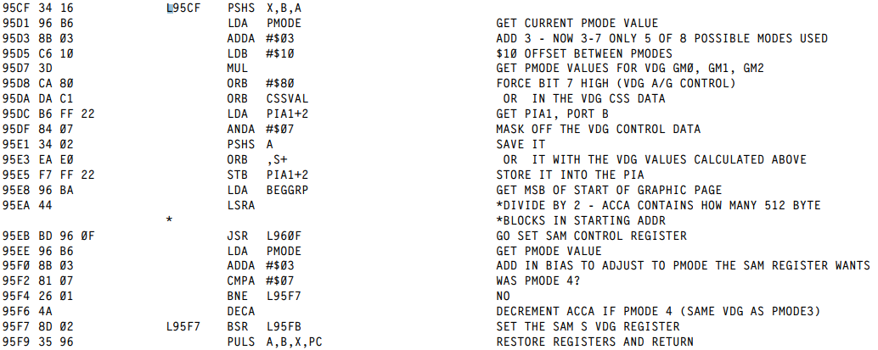
ECB - Graphics SCREEN
http://www.colorcomputerarchive.com/coco/Documents/Books/Unravelled%20Series/extended-basic-unravelled.pdf
Notes:
Instead of listing out the pokes or data statements for the places in BASIC where we need to make our changes for 64-column mode, I’m going to show some disassembly, courtesy Color BASIC Unravelled II and Extended Color BASIC Unravelled II.
The SCREEN command selects between either the configured high-resolution graphics PMODE (saved when using the PMODE command earlier) or the 32-column alphanumeric and semigraphics displays.
The part of the routine shown here is the high resolution graphics part of SCREEN (as opposed to the alphanumeric portion). Note that on the 3rd line, it offsets by 3, losing access to CG1, RG1, and CG2 (sound familiar from a few slides ago?).
Then it points the SAM to the start of the graphics page, in our case, at hex E00, and also sets it up for the appropriate addressing mode to match the VDG.
No changes are necessary for this routine – this is background info necessary to understand the next step, because we want to use this routine.

Slide 15
ECB - Alphanumeric/SG SCREEN
95AE D6 B6 LDB PMODE SAVE PMODE IN B
95B0 86 FF LDA #$FF “-1”
95B2 97 B6 STA PMODE SET PMODE -1
95B4 BD 95 CF JSR $95CF CALL GFX
95B7 D7 B6 STB PMODE RESTORE PMODE FROM B
95B9 35 96 PULS A,B,X,PC RETURN
http://www.colorcomputerarchive.com/coco/Documents/Books/Unravelled%20Series/extended-basic-unravelled.pdf
Notes:
This is the part of the SCREEN routine which sets the SAM’s display page to address hex 400 and the VDG to alpha-numeric mode.
We want to change this so that the SAM doesn’t ever point back to this address and the VDG is always left in a graphics addressing mode (which, of course, CoCoVGA will interpret as ASCII and semigraphics data).
Starting at hex 95AE, we want to load register B with the current PMODE for safe keeping, then overwrite it with a -1 (hex FF), then call the routine at hex 95CF (that we just saw on the previous slide). That routine will add -1 to the offset 3 and get a VDG mode of 2, which was our goal. The value saved in register B will have been pushed onto the stack and when we return from the SCREEN graphics call, the B register will have the original PMODE back again. We can then restore PMODE so that other parts of BASIC won’t know that we are using a graphics addressing mode and we won’t have to fix up any PMODE bounds checks elsewhere in BASIC.
This listing is just what needs to be poked into memory at these locations…

Slide 16
CB – Display Device Bounds
A375 C4 3F ANDB #$3F COLUMN MASK
A37A 86 40 LDA #64 LINE WIDTH NOW 64
A34E EC 88 40 LDD 64,X GET FROM NEXT LINE
A353 8C 15 C0 CMPX #$E00+1984 ON LAST LINE?
http://www.colorcomputerarchive.com/coco/Documents/Books/Unravelled%20Series/color-basic-unravelled.pdf
Notes:
The above gets us about 75% of the way there. We would be done so long as we don’t care to address the entire 2kB of text video memory, but right now Color BASIC thinks we still only want to address 512 bytes at hex 400.
So to resolve that, we just need to fix up various constants in print configuration, scrolling, and set/reset, among a few others. I’m highlighting in yellow the pokes that can be issued from BASIC to do these fixes.
Here we are tweaking the print parameters for the display device. You can see changes here from 31s to 63s and 32s to 64s as related to columns and related to the address of the first character of the last line on the screen for checking on the need to scroll the display up.

Slide 17
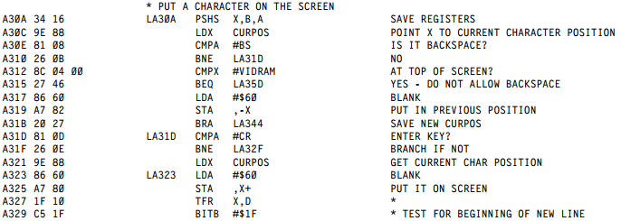
CB – Output a Character
A312 8C 0E 00 CMPX #$E00 START OF SCREEN
A329 C5 3F BITB #$3F START OF NEW LINE
A346 8C 15 FF CMPX #$15FF END OF SCREEN
A34B 8E 0E 00 LDX #$E00 START OF SCREEN
http://www.colorcomputerarchive.com/coco/Documents/Books/Unravelled%20Series/color-basic-unravelled.pdf
Notes:
Here are some code segments that are used to place characters on the screen and track cursor position. We need to adjust start and end addresses and help it recognize that when all 6 (instead of 5) least-significant bits of the cursor position are 0, then that’s when the cursor is at the start of a new line.

Slide 18
CB – PRINT and CLS
Cursor bounds check for PRINT @
A557 83 07 FF SUBD #2047 2048 LOCATIONS
A55E C3 15 FF ADDD #$E00+2047 END OF SCREEN
CLS
A92A 8E 0E 00 LDX #$E00 START OF SCREEN
A931 8C 15 FF CMPX #$E00+2047 END OF SCREEN
http://www.colorcomputerarchive.com/coco/Documents/Books/Unravelled%20Series/color-basic-unravelled.pdf
Notes:
Here are some more size and address constants needed to be changed for PRINT @ - we can now PRINT @ all the way up to 2047 – and CLS, so that it actually clears the whole screen.

Slide 19
CB – SET/RESET Address Calculations
A8CA C1 7F CMPB #127 128 HORIZ BLOCKS
A8D3 C1 3F CMPB #63 64 VERTICAL BLOCKS
A8DA 86 40 LDA #64 64 BYTES/ROW
A8DD 8E 0E 00 LDX #$E00 TOP OF SCREEN
http://www.colorcomputerarchive.com/coco/Documents/Books/Unravelled%20Series/color-basic-unravelled.pdf
Notes:
Both SET and RESET call this function for the purposes of address calculations to turn their parameters into semigraphics. We need to adjust these bounds checks and another start address offset.

Slide 20
CB – Cassette Status
A6F3 B6 0E 00 LDA #$E00 START OF SCREEN
A6FD B7 0E 00 STA #$E00 START OF SCREEN
http://www.colorcomputerarchive.com/coco/Documents/Books/Unravelled%20Series/color-basic-unravelled.pdf
Notes:
And last, but not least, there is the cassette status – you know, the blinking Ses and Fs that show up in the top left corner of the screen? If we want to see those, we need to point this routine to the start of our new 64-column region.

Slide 21
Finishing Touches
470 CP=(PEEK(&H88)-4)*256+PEEK(&H89):CP=CP*2+&HE00
490 SCREEN 0,0 ‘USE NEW TEXT SCREEN COMMAND
500 CLS ‘USE NEW CLS COMMAND
520 POKE &H88,INT(CP/256):POKE &H89,CP AND &HFF
530 REM REPLICATE 32-COLUMN DISPLAY ONTO 64-COLUMN DISPLAY
540 FOR I=0 TO 15
550 FOR J=0 TO 31
560 POKE &HE00+I*64+J,PEEK(&H400+I*32+J)
570 NEXT J
580 NEXT I
590 PRINT "*** cocovga 64 column mode ***"
600 END
Notes:
We’ve done all our patches into the ECB and CB ROMs (that are now in RAM), so to wrap this all up, we are now going to:
Grab cursor location from BASIC (since CLS is about to move it)
Use our new SCREEN 0 to get the VDG into the appropriate mode
Issue CLS to get us a clean slate in our new 64-column text memory
Reprogram the cursor position based on the value we saved before CLS
Copy original 32-column text from $400-$5FF to $E00-$15FF to make the switch from 32 to 64 columns appear “seamless” and let the user see where they left off.

Slide 22
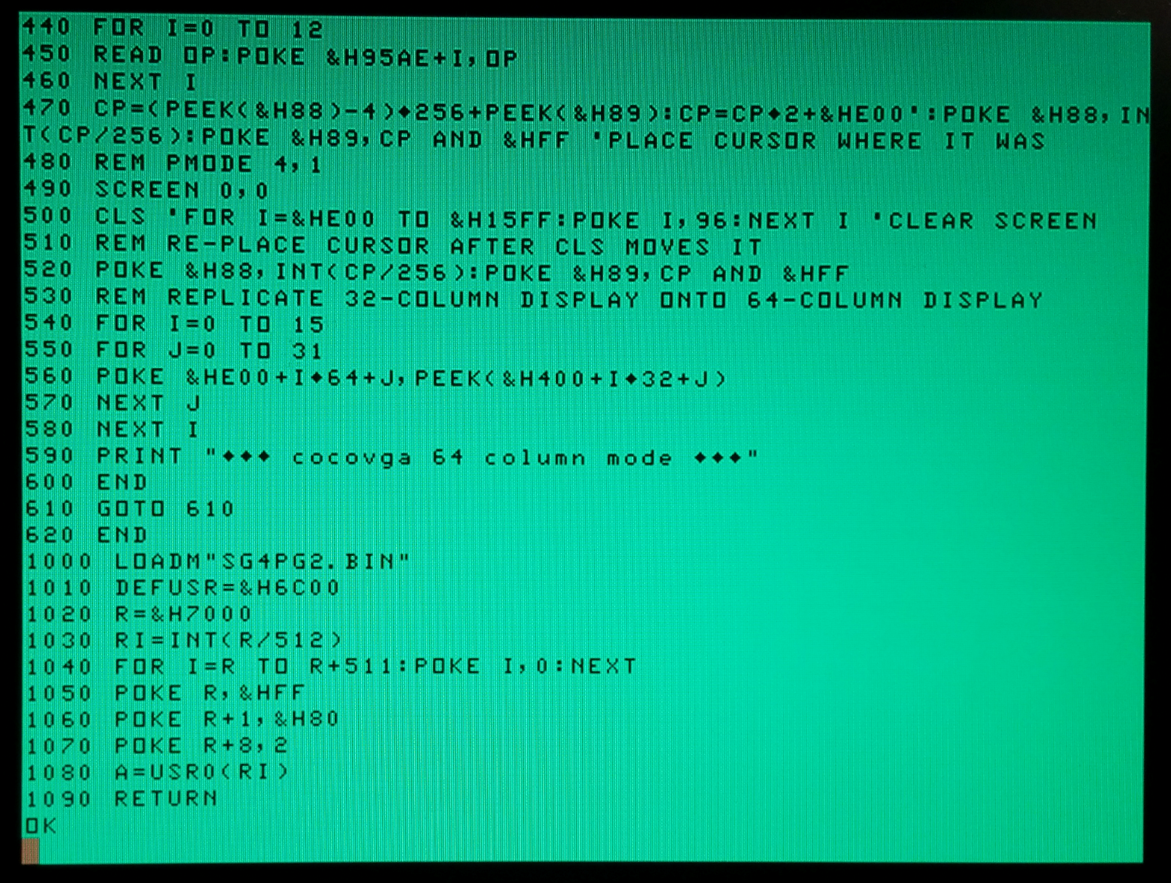
Example Screen Shot

Slide 23
Any questions?
For a demo please come by my table.
Please also visit:
www.cocovga.com
Notes:
Thanks for attending. Hopefully even if the particular aspect of running 64-columns doesn’t interest you, perhaps you can see from this how easy it is to customize BASIC to what you might want it to do. I’d encourage you to give it a try – this is something I’d never done before and just started digging into the documentation I mentioned to do it.
I’ll post this slide deck on the CoCoVGA web site, just like I’ve done with the other presentations.

Slide 24
Current Configurable Features
Character set (original vs. T1) and lowercase enable (SG6 or forced)
5 artifact color modes & color swap
Border color (standard, T1, off, custom)
Scanlines
Video mode change status
Inverse video
Palette
Omit dark reverse-video colors
Disconnect text palette from SG palette
Independently select each color out of 512 possible:
9 SG colors, 2 text colors, 2 dark reverse-video colors
Scanline color
Up to 16 “dithered” artifact colors (MESS mode)
VGA timing
Enhanced 128x96 16-color mode in 6kB
Enhanced 64 column x 32 row text and SG mode in 2kB

Slide 25
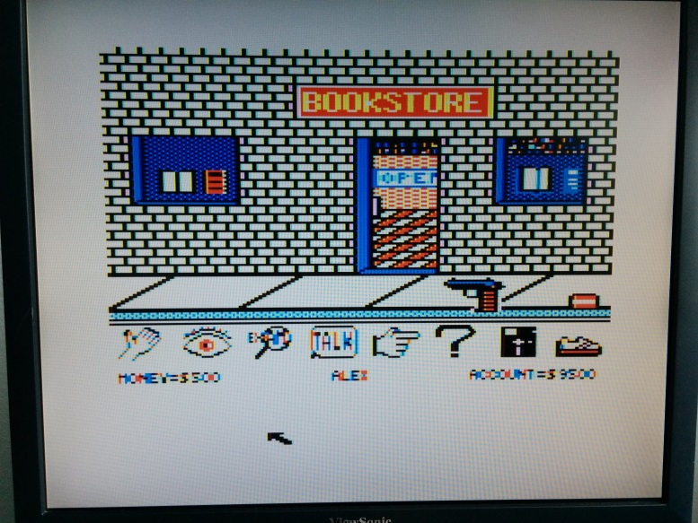
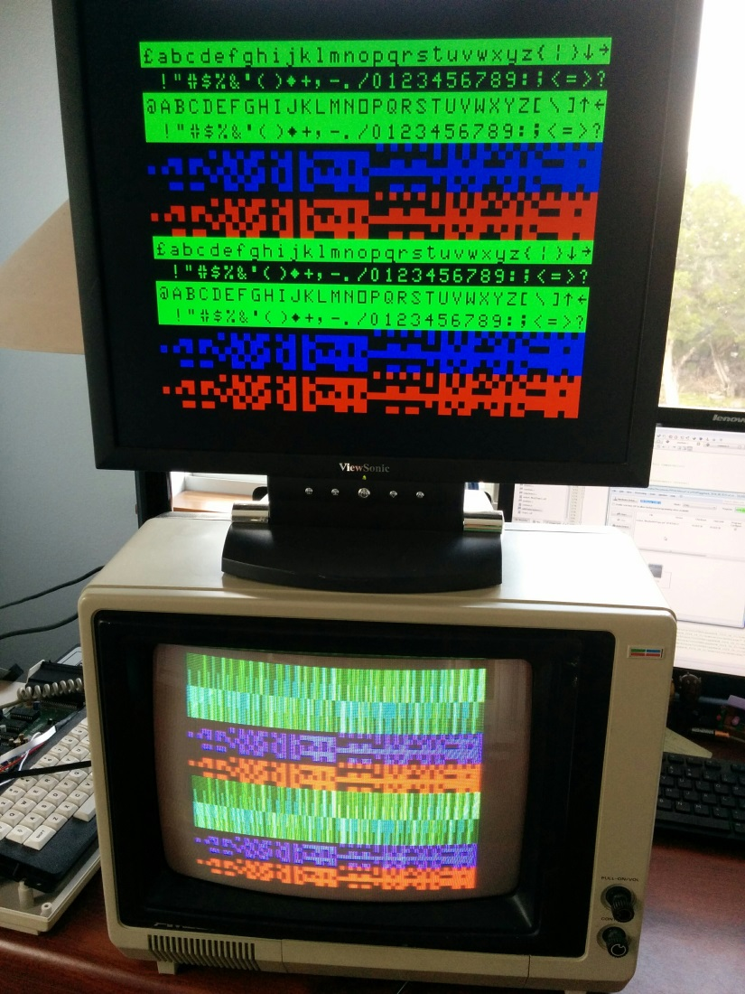
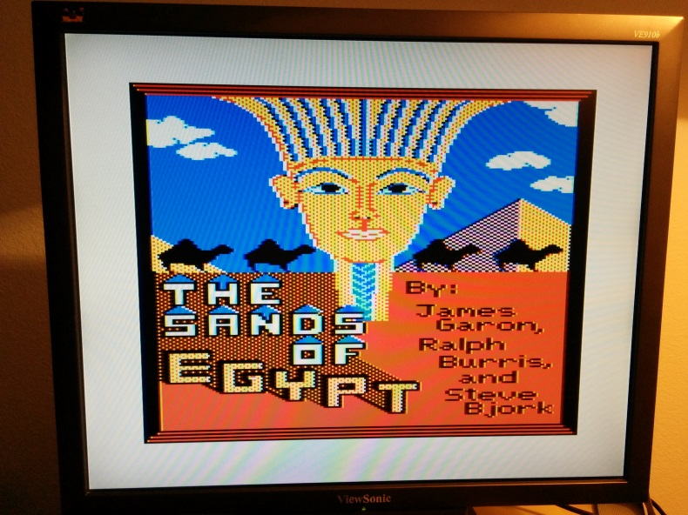
Screen Shots
Notes:
In the 2nd half of last year, I spent a lot of time with video modes and cleanup.
The left photo shows one CoCo driving both a VGA and composite monitor. SG6 and lower-case (which the non-T1 part cannot display) are visible on the VGA monitor. (The optional re-use of SG6 for lowercase, I believe, was a suggestion from Art Flexer.)
On the right are a couple of games that rely heavily on artifacting. These pictures show the MESS-style artifact mode.

Slide 26
Software Mode Control
blanking region n+0
video frame n+0 (CoCoVGA will display this)
program CoCoVGA combo lock
point SAM to alternate video frame which contains register settings
blanking region n+1
video frame n+1
(not actually video, but
register settings – CoCoVGA will not display this)
time
blanking region n+2
point SAM back to “displayable” video frame
video frame n+2 (CoCoVGA will display this)
blanking region n+3
Notes:
Want to program all of these settings, but need to do it in such a way that it doesn’t disturb video output.
Ideally we would program all registers during blanking region, but it could be tight.
1/60 second = 16.6s
Vsync for 32 scanlines our of 262 scanlines for the full display: 32/262 = 12.2% of image
12.2%*16.6s = 2.04ms
~1811 6809 clocks during FS
In other words, assuming average of 2.5 cycles/instruction, ~724 machine instructions during blanking period.
I would prefer to have a frame’s time to program it AND not have to bit-bang the PIA during the blanking period. So let’s let it read its own registers out of “video memory”.
Now review slide...
CSS, A/G, GM concatenated and used as 5-bit combination lock.

Slide 27
CoCoVGA Snooping 6847
CSS, GM[2:0], A/G
VGA video
CoCoVGA
VGA monitor
DD[7:0]
DA[12:0]
6821
PIA
DRAM
DA[15:0]
6883
SAM
TV
DA[0]
NTSC video
6847
VDG
TV
Modulator
DD[7:0]
CSS, GM[2:0], A/G
analog video
Notes:
In CoCo, pins DD[6] also connected to INV and DD[7] also connected to A/S.

Slide 28
CoCoVGA Internal Architecture
FS
syncGen
VGA video sync
HS
VGA RGB
6847 video sync
D[12:0]
frameBuffer0
addrDataCapture
DD[7:0]
wrAddr
DA[12:0]
rdAddr
D[12:0]
PixelGen
A/G, A/S, CSS, INV
D[12:0]
D[12:0]
frameBuffer1
clockGen/
resetGen
wrAddr
rdAddr
Notes:
clockGen divides down 50MHz XTAL to 25MHz for pixel clock and samples/synchronizes the 6847 clock to pixelClk so that it pulses on both edges
syncGen samples FS (field sync) and HS (horizontal sync) to synchronize sampling in addrDataCapture as well as provide VGA VSYNC and HSYNC
addrDataCapture samples address and data on 6847 pins at the correct time, writes data and mode bits in frameBuffer as well as providing address to frameBuffer for reading
frameBuffers alternate reading/writing so that screen tearing doesn’t occur. This means that there are situations in which the displayed video may be 1/60th of a second behind a TV. Will have to see if gamers such as Neil or Stevie can notice it.

